Slide 1
SQL PROJECT
MANSI ACHARYA

Slide 2
This is a project on Music sales analysis. The dataset was downloaded from Kaggle and the analysis was performed on SQL server management studio.
The dataset had twelve different tables which are connected. The tables contained the following information:-
1. Album
2. Customer
3. Employee
4. Artist
5. Invoice
6. Invoice line
7. Track etc…..

Slide 3
Problem statements :-
1. Who is the senior-most employee based on job title?
2. Which country has the most invoices?
3. What are the top 3 values of the total invoice?
4. Write a query that returns one city that has the highest sum of invoice totals.
5. Write a query that returns the customer who has spent the most money.
6. Write a query to return the first name, last name and email of all rock music listeners.
7. Write a query that returns the artist name and total track count of the top 10 rock bands.
8. Return the track names which have song lengths more than the average song length of all the tracks. Order the song length with the longest song listed first.

Slide 4
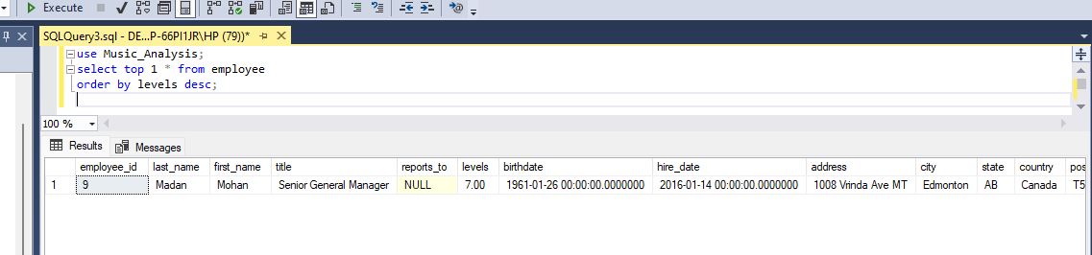
Who is the senior-most employee based on job title?

Slide 5
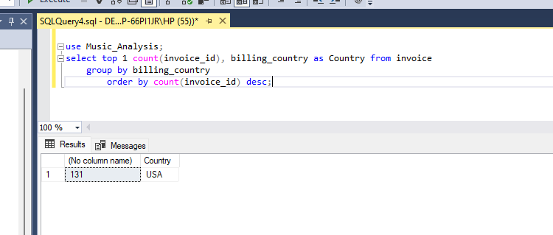
. Which country has the most invoices?

Slide 6
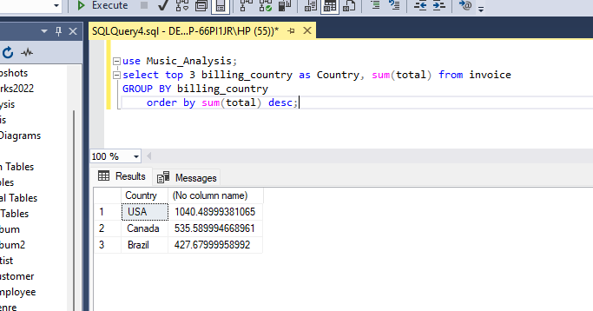
Which are the top 3 countries with most invoices?

Slide 7
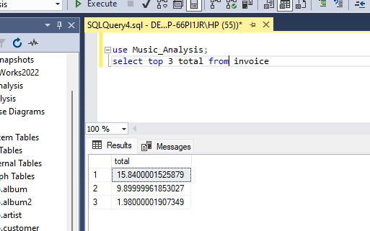
What are the top 3 values of the total invoice?

Slide 8
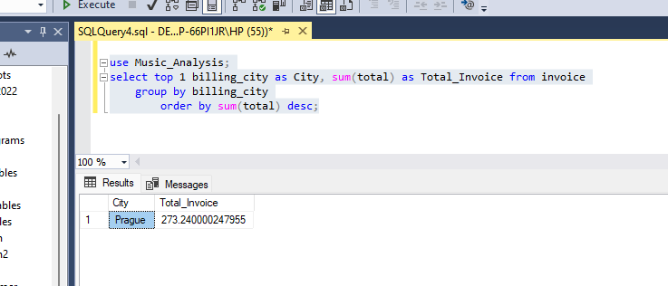
Write a query that returns one city that has the highest sum of invoice totals.

Slide 9
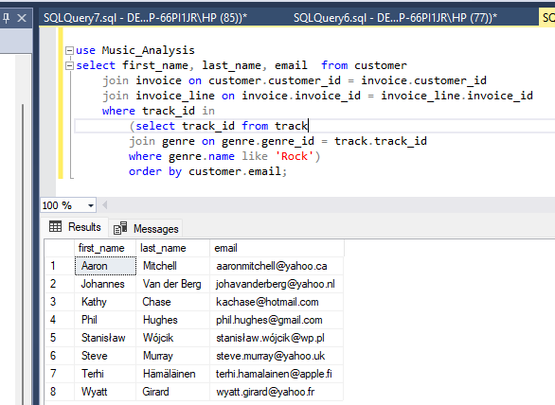
. Write a query to return the first name, last name and email of all rock music listeners.

Slide 10
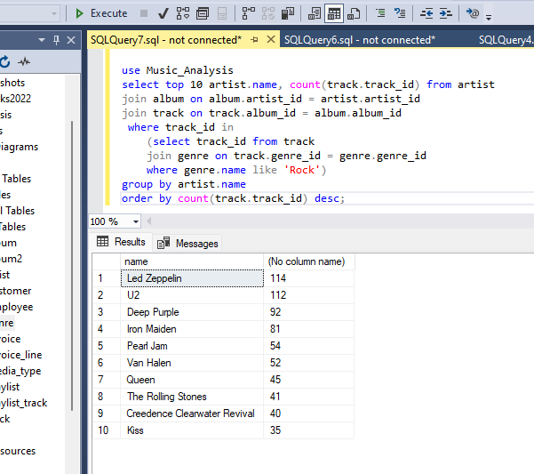
. Write a query that returns the artist name and total track count of the top 10 rock bands.

Slide 11
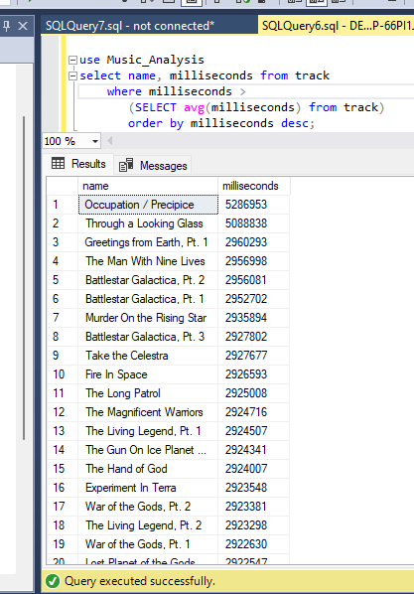
Return all the track names with song lengths larger than the average. Return the name and millisecond of each track

